Slide 1
VORBIS AUDIO CODEC
By
Bharan, Prasad, Kulin and Sanjay

Slide 2
Bird's Eye View
Currently a growing audio format (internet streaming)
Open-Source, Non-Proprietary, Patent-Free, and Royalty-Free
Lossy audio codec – Lossy (psychoacoustic)?, Lossless (entropy)?
Good all-round performance (>48 kbps - a leading codec at 128 kbps)
  Same competitive class as MPEG-4 (AAC), and higher performance than MP3, WMA.
Well written specifications and documentation (from the decoder’s point of view)
High potential for further tuning (Vorbis II)
Supported by most portable Digital Audio Players (DAPs)

Slide 3
Background
Result of making MP3 proprietary by Fraunhofer Institute, Germany
First of a family of codec by xiph.org
Ogg= general purpose container stream format
Vorbis= psychoacoustic audio codec
Ogg comes from a Netrek term ‘ogging’
Vorbis – Discworld character- High priest – Small Gods

Slide 4
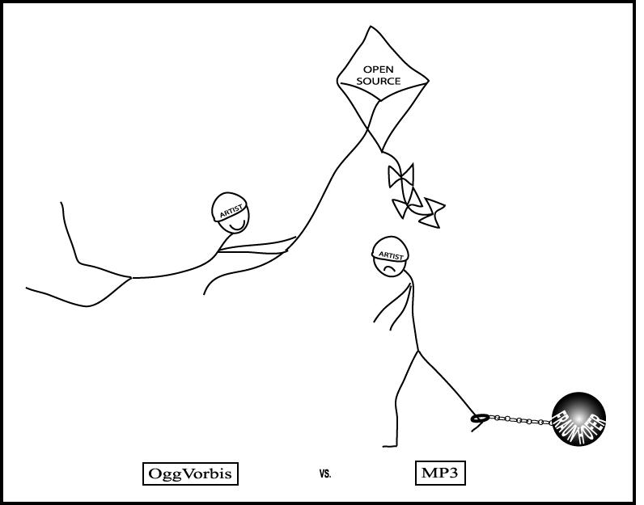
Ogg or MP3?

Slide 5
Speech Vs. Audio CODEC
Speech Codec
  Designed to deal with characteristics of voice.
  Speech has maximum frequency of 7 kHz. It looks for speech patterns and tries to compress data further.
  Only intelligibility of speech is important for codecs and hence a lot of statistical info. related to emotions, etc. can be dropped. They has comparatively lower bit rate.
  Ex. u-law PCM
Audio Codec
  Audio codec are developed for music (Audio signals).
  Audio signals have comparatively larger frequency range of 20 Hz to 20 kHz.
  They have comparatively higher bit rate.
  Ex. Ogg vorbis

Slide 6
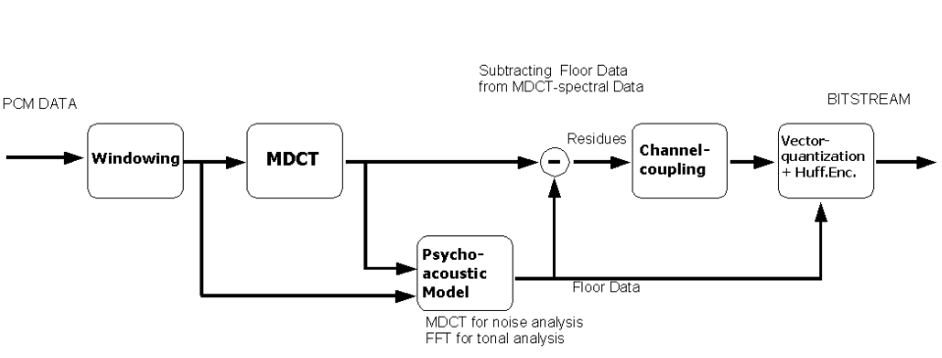
Vorbis Audio Codec

Slide 7
Channel Coupling
Eliminates inter-channel redundancies
Eliminates stereo image info labelled unimportant by the psychoacoustic model
Two types
  Channel interleaving
  Square polar mapping
Vorbis supports multi channels (>2, ex. Vorbis 5.1 5-channel surround)

Slide 8
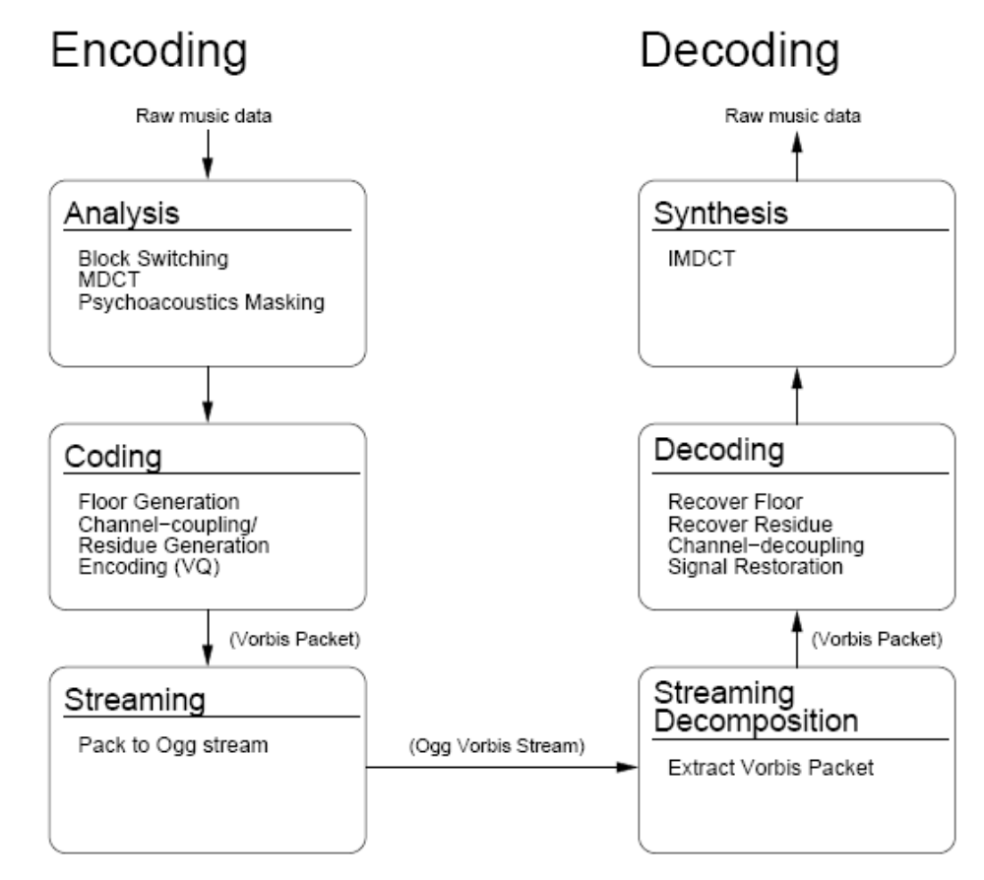

Slide 9
MDCT(MLT)
Most expensive step as far as Vorbis decoding is concerned
Maps an K real nos. to an array of K/2 real nos.
Used in most second generation audio codecs including MP3 and Ogg Vorbis
Basically DCT with 50% overlap window

Slide 10

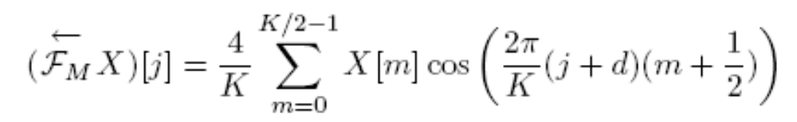
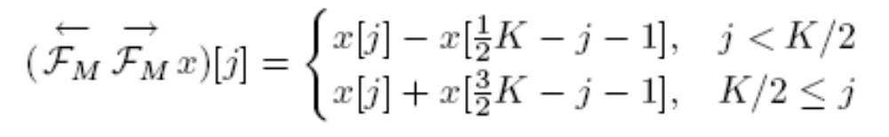
MDCT Equations
MDCT followed by IMDCT - ?
Prove it…

Slide 11
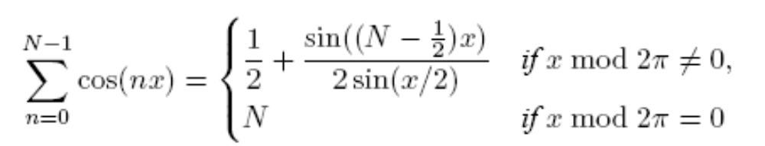
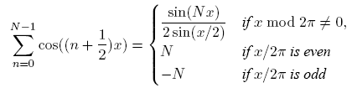
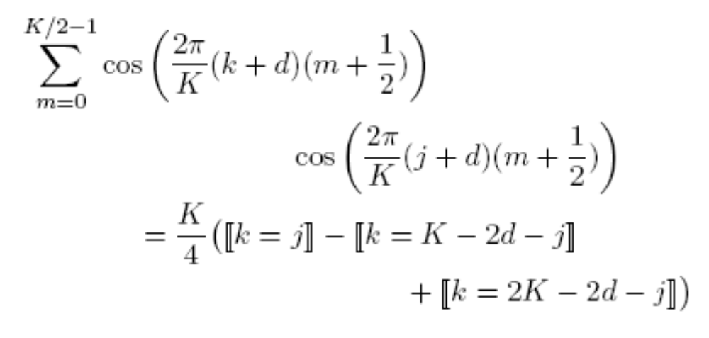
MDCT Equations
First prove: assume j>=0 and k<K

Slide 12
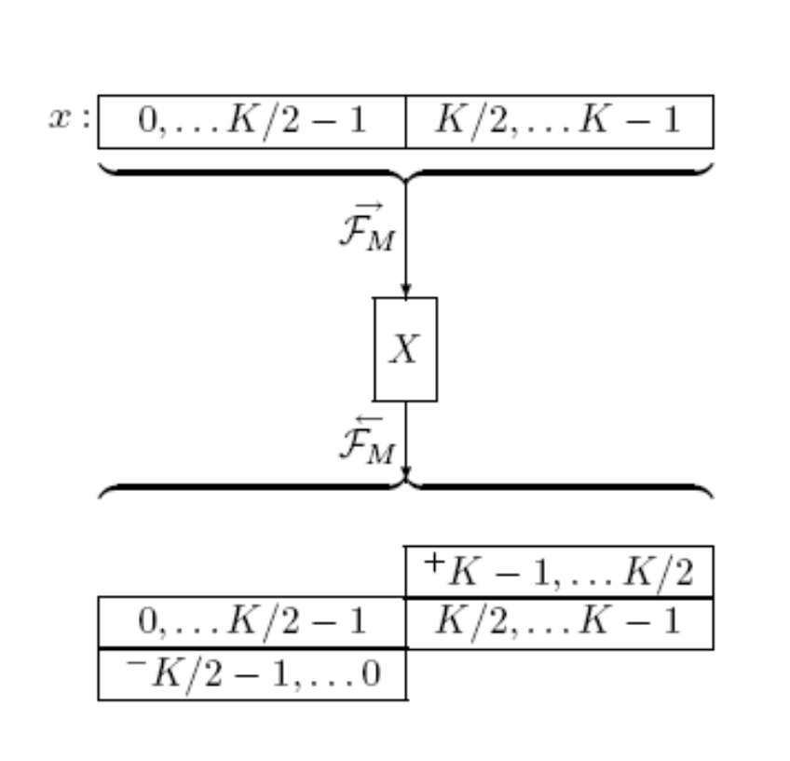
Result of MDCT followed by IMDCT

Slide 13
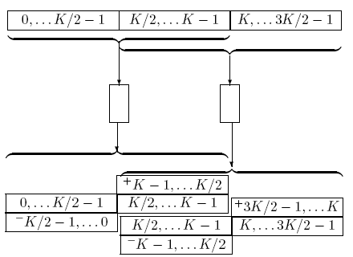

The beauty of MDCT- TDAC

Slide 14
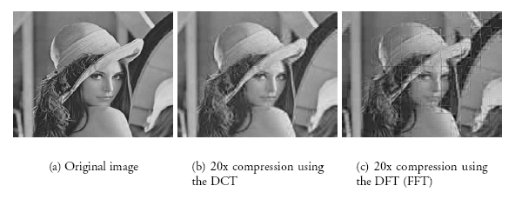
So what’s the Big deal?
Could have used FFT on non overlapping window?? Issues? – ‘ Block Artifacts’
Multiply by window before and after the transform – known as ‘block switching’
Long window- 2048 samples, short window- 256 samples

Slide 15
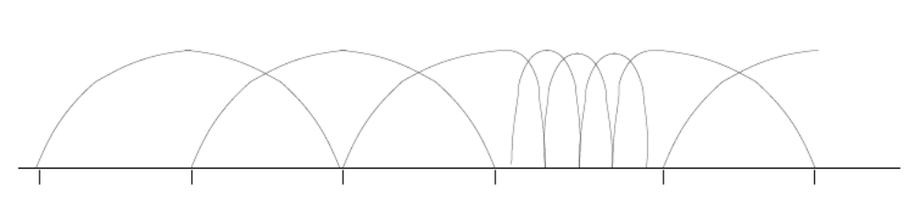
Windowing results
To cancel alias:
  Shape of windows in succeeding blocks must fit to each other only in the overlapping part
  Longer- shorter split
  Symmetry in each half of window

Slide 16
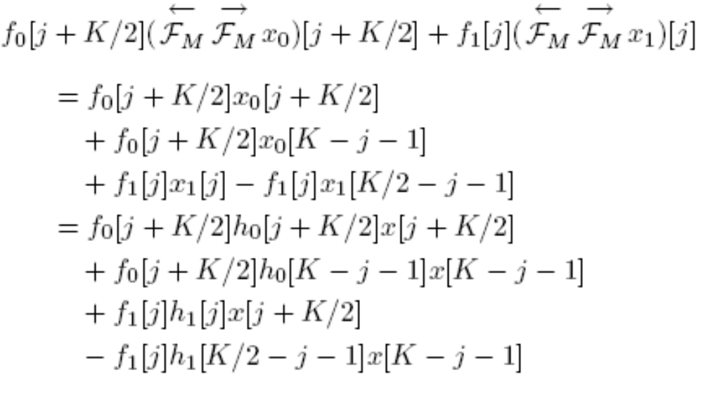
Windowing results

Slide 17
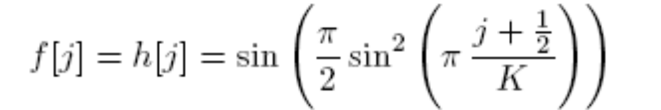
Windowing results
The window used in vorbis is
Better stop-band attenuation at the expense of lesser pass-band selectivity
You can verify that it satisfies the previous set of eqns.

Slide 18
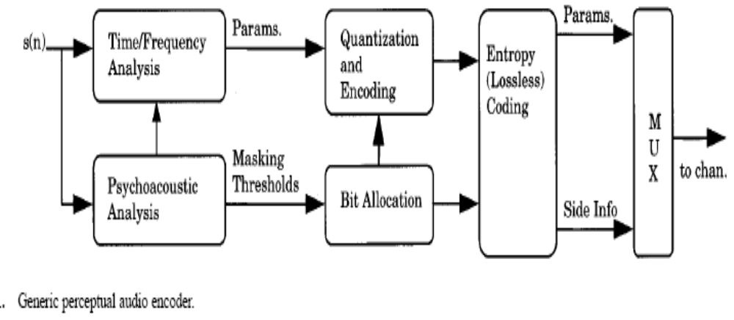
GENERIC PSYCHOACOUSTIC CODER

Slide 19
PSYCHOACOUSTIC PRINCIPLES
Removing the “irrelevant” signal information
Psychoacoustic metrics are
  Absolute threshold of hearing
  Critical bands
    Neural receptors in Cochlea(inner ear) containing basilar membrane
    Bank of highly overlapped BPF
    Non-uniform bandwidth increases with frequency

Slide 20
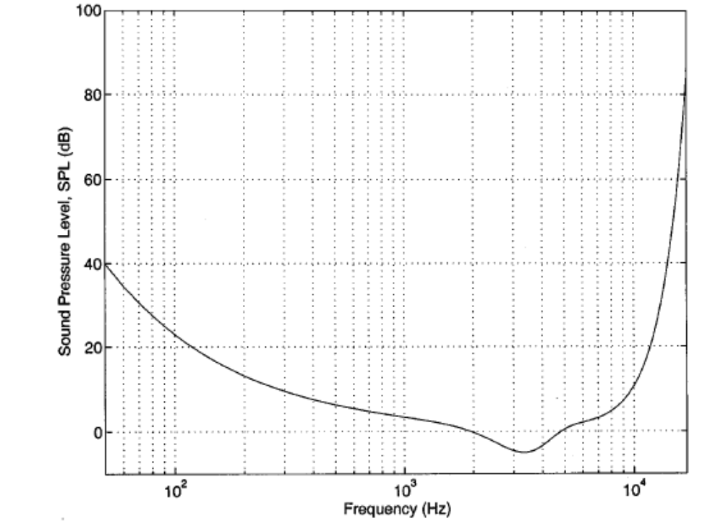
Absolute threshold of hearing in quiet

Slide 21
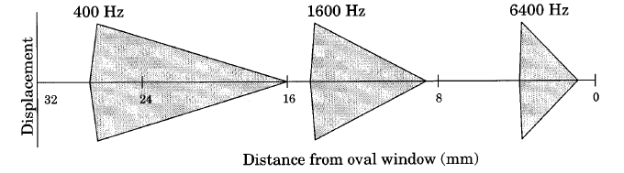
Critical bands-frequency to place transformation

Slide 22
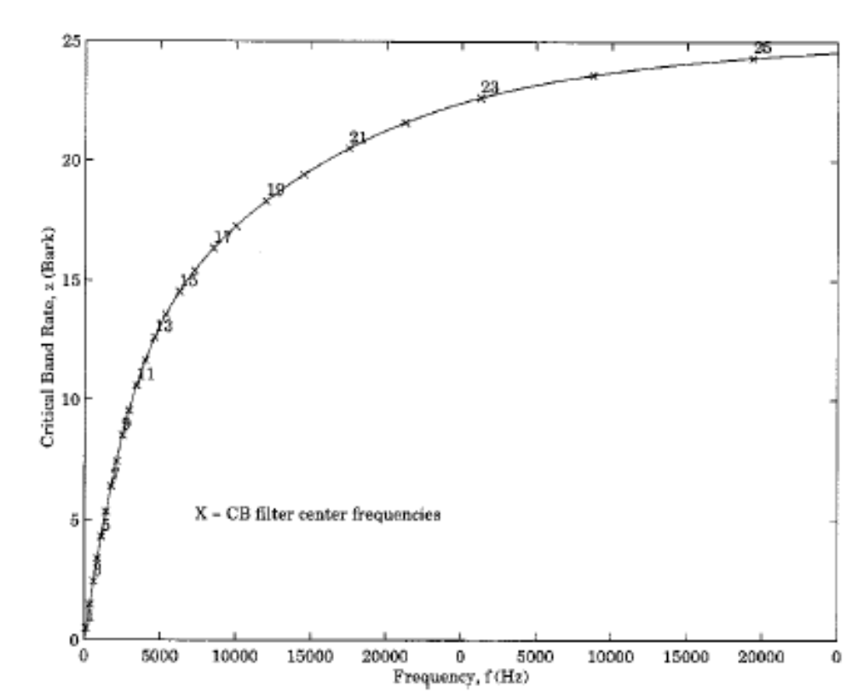
Critical band-rate as a function of frequency

Slide 23
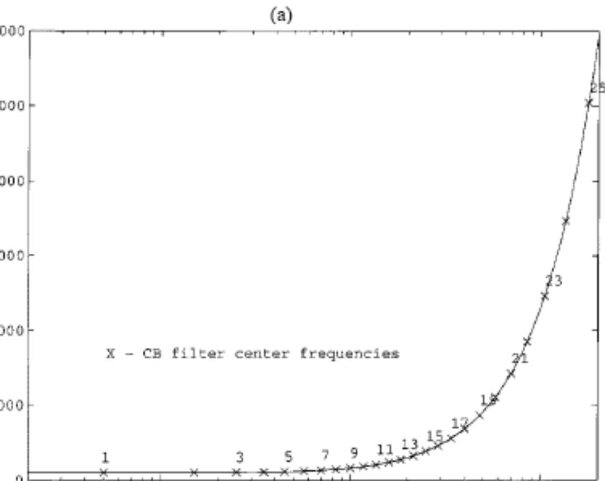
Critical bandwidth as a funtion of center-frequency

Slide 24
PSYCHOACOUSTIC PRINCIPLES Contd.
Simultaneous masking, asymmetric masking and spread of masking
  Noise masking tone
  Tone masking noise
  Noise masking noise

Slide 25
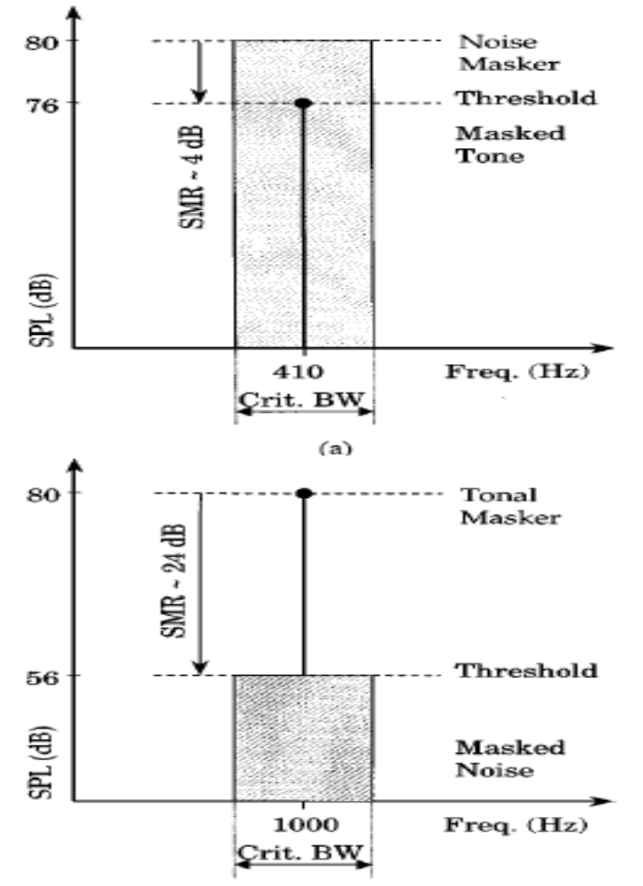

Slide 26
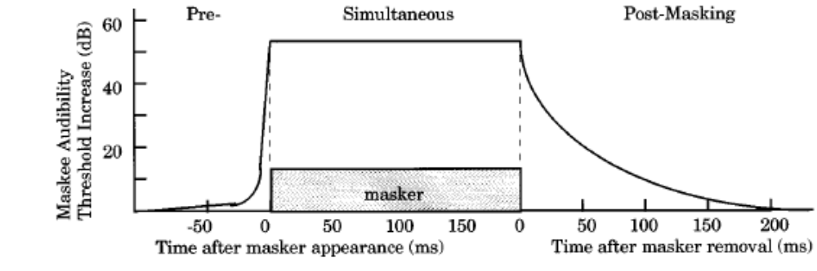
PSYCHOACOUSTIC METRIC
Non-simultaneous masking

Slide 27
PSYCHOACOUSTIC METRIC
Perceptual entropy
  Signal is windowed and transformed to frequency domain
  Masking threshold using perceptual rules
  Using PE histogram the no. of bits required to quantize the spectrum

Slide 28
VORBIS MODEL
Encode side psycho-acoustic heuristics
Each audio-spectrum floor curve is generated
  Tone masking
    Single spectral curve per frame which represents the threshold of perception per spectral line
  Noise masking
    Envelope of noise energy in the spectrum
    Adds hard-wired noise-offset producing noise-mask curve

Slide 29
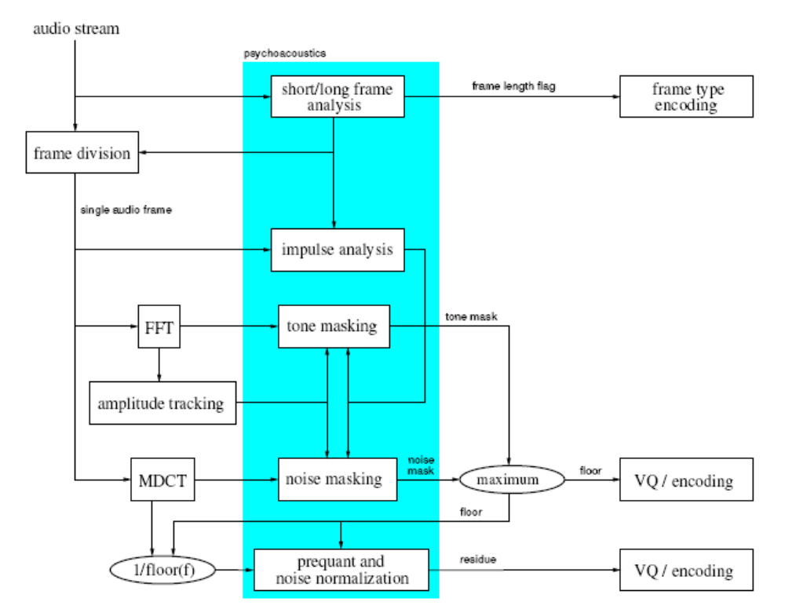
Psycho acoustic model in VORBIS

Slide 30
VORBIS MODEL
Noise normalization
  To preserve the noise-masking curve through quantization process
  Impulse analysis
  Refers to localized temporal events.
  Improves the non-sinusoidal, non-random-noise content

Slide 31
VORBIS MODEL
Floor curve= max( tone mask, noise mask) after direct superposition
Spectral residues= MDCT spectrum- floor curve
Floor and residue curves are then vector quantized
Vorbis audio codec uses Spectral flatness measure curve
This curve is made using Geometric median and envelope followers by smoothing the log spectrum using sliding window of 1 bark
Distances tell about tonality and noisiness

